Slide 1
Pharmacologic Treatment of Schizophrenia
Student’s Name
Institution of Affiliation
Course Code and Name
Professor
Date

Slide 2
Primary Question
Objective:
To review and highlight recent developments and current controversies in the pharmacological treatment of schizophrenia.
To highlight areas where there gaps in the knowledge exist
To suggest research best suited to fill these gaps
Primary Question:
What are the recent developments in the pharmacologic treatment of schizophrenia?
What are the current controversies surrounding the pharmacologic treatment of schizophrenia?

Slide 3
Innovation of Research Question
Based on:
researcher’s interest and approach to the topic
The need to identify information gaps regarding the topic
Was centered on the desired outcome
Application:
Helps in:
identification the information gaps in the body of knowledge
informing directionality of future research
Relevance:
providing comprehensive knowledge basis that would help to significantly improve the pharmacologic management of the disease

Slide 4
Significance of Primary Question
It helped to highlight the areas that need improvement where the treatment of the disease is concerned.
It helped to highlight the recent development in the pharmacologic management of the disease.
It helped to highlight the current controversies that are associated with this type of treatment
It helped to highlight new areas that would require further research
It helped to bring all the information regarding the pharmacologic treatment of schizophrenia in one place

Slide 5
Societal Impact of Primary Question
It helped the society to appreciate further the manner in which the pharmacologic treatment of schizophrenia works
It helped to highlight the important position that pharmacologic treatment of this disease assumes within the life of the individual
It helped in providing more insight into the controversies of the pharmacologic treatment of the disease
Provided guiding principles that would enable the individual to be informed about their treatment options and hence monitor their treatment more effectively

Slide 6
Procedure: Methodology
Descriptive approach to the research questions
Systematic Meta-analysis of available literature
Guiding hypothesis:
By way of identifying the information gaps within the existent body of knowledge through systematic and comprehensive review, the type of research ideally suited to fil these gaps can be identified and discussed
Review of ALL available information on the topic

Slide 7
Sustainability and Limitations of the Methods
Sustainability:
Provided a bulk of information was instrumental in answering the major research questions
Limitations:
Failed to provide:
inclusion criteria of how they chose the literature that they reviewed
expound more on the scheme that they applied in their review making their research impossible to replicate
provide the research recommendation of some of the research topics that they had identified

Slide 8
Hypothesis Explanation
Hypothesis:
By way of identifying the information gaps within the existent body of knowledge through systematic and comprehensive review of available literature, the type of research ideally suited to fill these gaps can be identified and discussed.
Explanation:
Theirs was guided by the need to identify gaps in the knowledge that is rooted in the topic
By identifying the gaps and the controversies, they could identify potent research question
From the research question identified, they can then deduce viable research suited to address each topic an hence fill these gaps

Slide 9
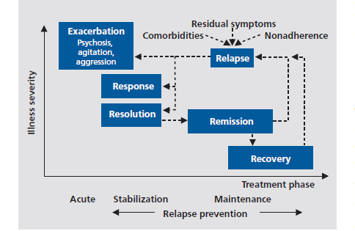
Results: Recent Developments
Summary of the treatment stages being used currently in the pharmacologic treatment of the disease.

Slide 10
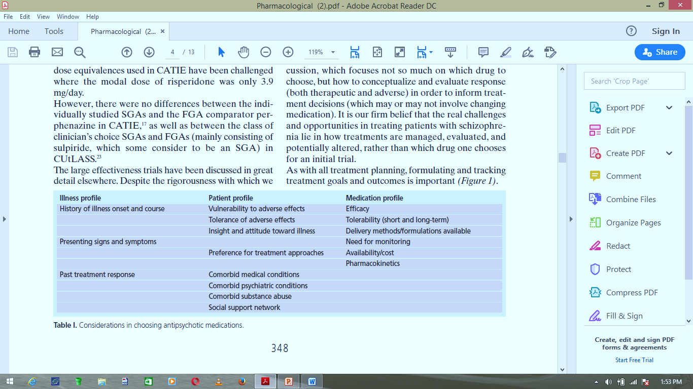
Results: Recent Developments
First vs. Second-generation:
Shift in prescribing practices and ensuring cost- effectiveness of the therapy employed
Considerations in Choosing Antipsychotic regimens:

Slide 11
Results: Recent Developments
Relative Efficacy:
Response rates are to treatment is quite high among people with the first-episode or those with rapid –onset illness
Subsequent management of the disease tends to favor second-generation drugs e.g. Olanzapine; Risperidone
Treatment Outcome:
Need to use quantitative assessment instruments in determining response to treatment
Propensity to achieve remission in some patients within 4 to 6 weeks
Increased acceptance of the concept of RECOVERY since functional outcomes are the ultimate goals of interventions

Slide 12
Results: Current Controversies
Efficacy of Clozapine in managing negative symptoms of schizophrenia
Comparative data on the propensity of the drugs to produce neurological Adverse Effects – extrapyramidal effects: acute dystonia reaction, akathisia, parkinsonism, tardive dyskinesia
Second-generation drugs – increased propensity for metabolic adverse effects e.g. insulin resistance and dyslipidemia
There is need to conduct research that would provide an appropriate validated dose equivalences of the specific medications across a range of illness phases, patient ages, and outcome domain, that is, therapeutic and adverse effects

Slide 13
Interpretation
Most antipsychotic drugs have been compared to the novel Haloperidol – the marketed leader at the point
This comparison raised logical concern that?
“the choice of that medication, and its utilization in potentially higher that necessary doses, might have served to accentuate differences in the risk for neurologic adverse effects” (Kane & Correll, 2010)
Implication:
This old comparison led to significant overdoses of the specific antipsychotic drugs with resultant increased propensity for the occurrence f drug adverse effects

Slide 14
Ethical Questions
Regarding the literature they chose to review:
Did they follow all ethical consideration of research using human subjects?
Were any subjects harmed during the research?
Did they seek approval from the relevant ethical committees and boards to conduct the research?
Was their research conducted with strict adherence to all the ethical principles of research?

Slide 15
Future Impact
Helps to highlight the things to put into consideration by future researchers looking to replicate the research done here
Provide guidelines on how future researchers should conduct themselves in their research
Emphasizes the need to protect subjects from any and all harmful scenarios that could occur within the research settings
Continually prompts the generation of new ways to conduct research studies in an ethical manner

Slide 16
Relevance and Alternative Views
Relevance:
If science considers ethical values, then the lives of humans and other creatures are not endangered by destructive agents like atomic bombs and chemical weapons.
Measures should be taken to avoid using science against humans. This can be achieved by promotion of scientists' moral values.
Alternative Views:
Research ethics drawing from the moral principle of what is right and wrong or good or bad significantly limits the progression of research and hence development of the knowledge on human subjects

Slide 17
Conclusion
Hypothesis – Identifying knowledge gaps through comprehensive review of the available literature to help guide directionality of future research
Primary question – on recent developments and current controversies in the topic
Research – descriptive study
Method – Systematic meta-analysis of available literature
Key finding – need for provision of validated dose equivalences of the various antipsychotic drugs
Limitation – failed to identify their inclusion criteria which questions the validity of the literature use in the context of this research

Slide 18
References
Kane, M. J. & Correll, U. C. (2010). Pharmacologic Treatmnet of Schizophrenia. Pharmacological Aspects, 12(3): 345-357

